Slide 1
Mozilla study group
Let’s actually do it!

Slide 2
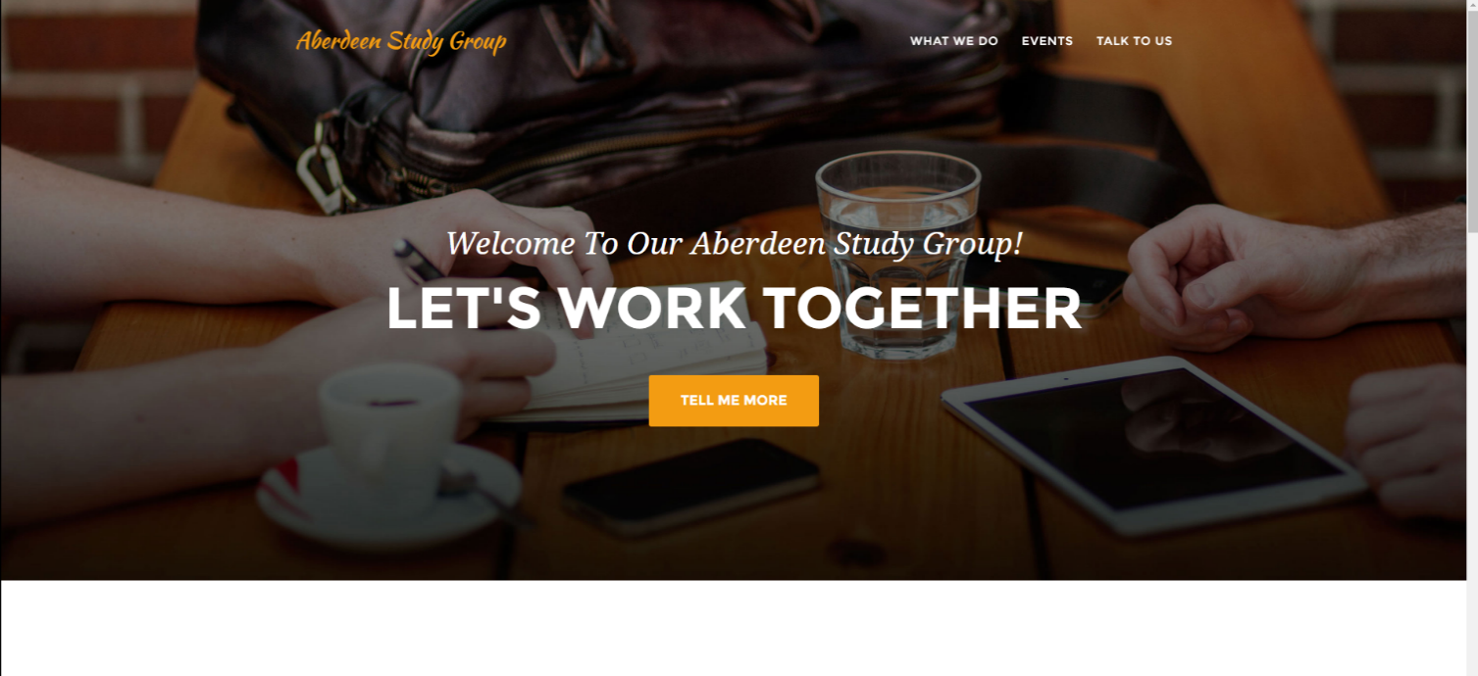
Updates
https://github.com/AberdeenStudyGroup/studyGroup
https://aberdeenstudygroup.github.io/studyGroup/

Slide 3
Updates

Slide 5
Updates

Slide 6
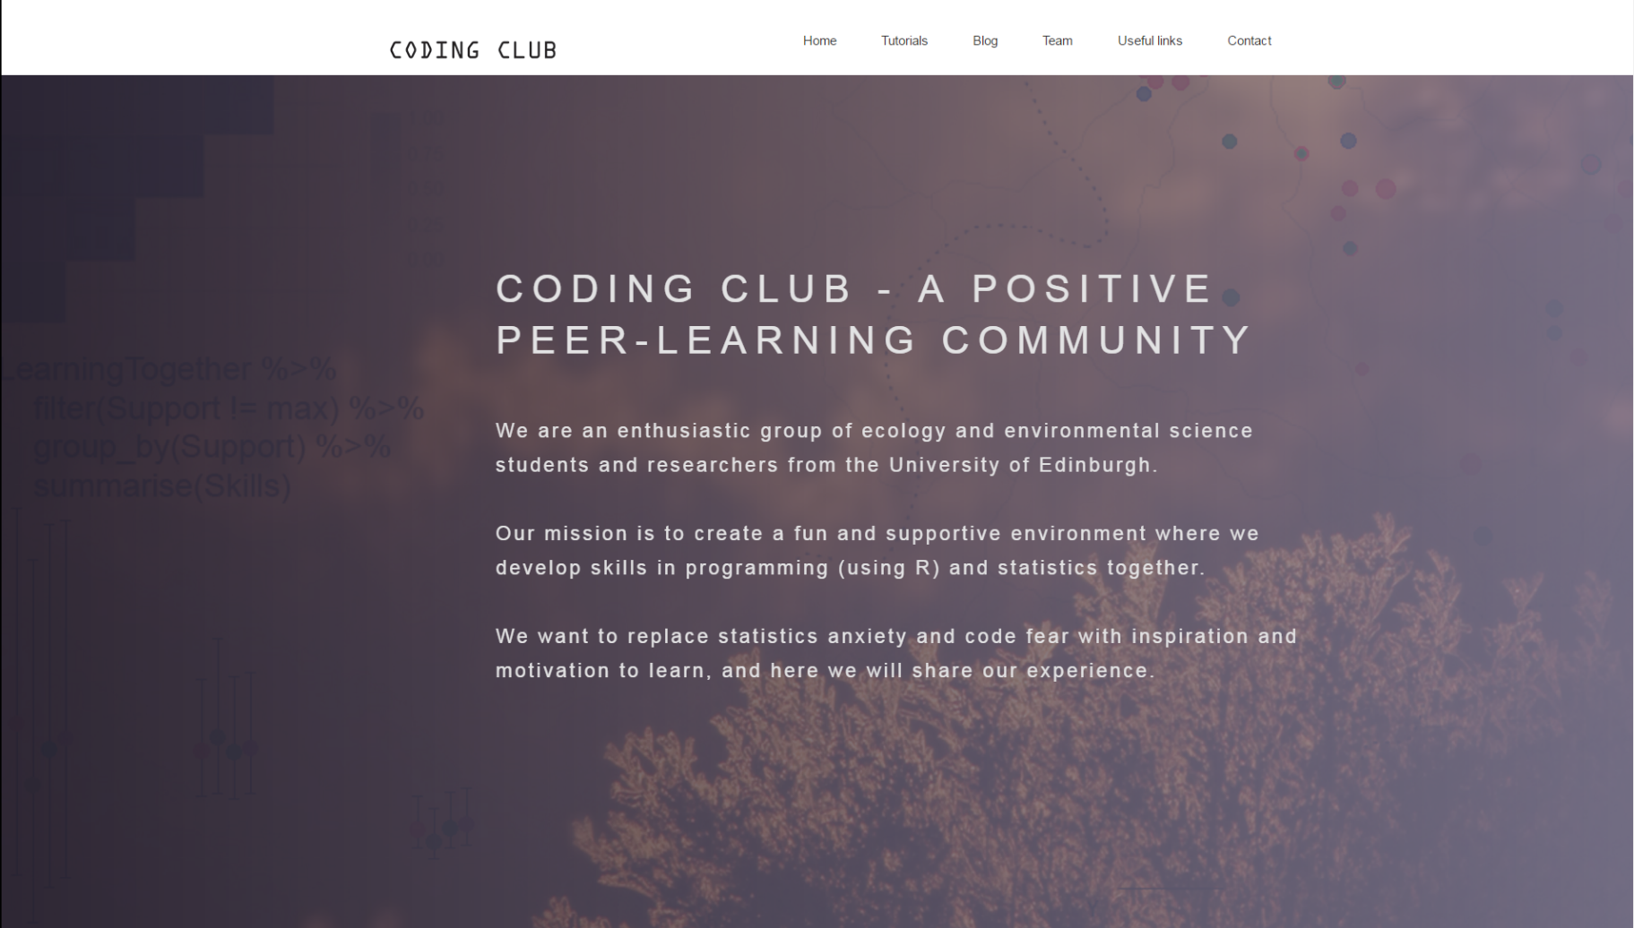
Updates
Aberdeen-Edinburgh
Joint Workshop
Save the date!
3rd April 9:00-11:30

Slide 7
We need to get started!
First event
Volunteers:
Hacky Hour (pub night)
When? (Friday at 4pm?)
Where? (The Bobbin? – can book big table with plugs)
Activities
How to advertise?
Me and Matthew: Version control and GitHub
Marianna: ggplot2
Ryan: for if statements
Ewan: methods for site selection for surveys
Richard: ggmap
Structure
Topics of interest:
How often?
Tutorials, co-working sessions, lightning demos, strategy circles, code reviews
Anything else apart from coding? (Discussions about open science and open data practices, copy right issues and open access?)
Where?
Blog?
Rmarkdown and knitr
Spatial R
Stats things
Dealing with messy data
Nice packages you’ve used recently
dplyr
How do we gauge interest

Slide 8
A big event

